Slide 1
Movie Review Sentiment Analysis Using A Neural Network
Justin Barry and Matthew Keeran, Team: 14

Slide 2
Background/Problem Statement
Bag of Words (BOW)
One hot vector representation
Vector size is vocab size N
One-hot vector representation for group of words
Shows no relationships between words, hence BOW
Word2Vec
Continuous Bag of Words (CBOW)
NN model that predicts a word based on its surrounding words and a window size
Skip-Gram (SG)
NN model that predicts the surrounding words given a target word and a window size
Show relationships between words: King - Man = Queen – Woman

Slide 3
Background/Problem Statement
{[The, cat, sat],[cat, The, sat, on],[sat, The, cat, on, the],[on, cat, sat, the, mat],[the, sat, on, mat],[mat, on, the]}
CBOW training
“The cat sat on the mat”
The vector for “cat” is used as the weights for node 1 and the vector for “sat” is used as the weights for node 2
Ex: [the, cat, sat]
Vec(“cat”) -> weights(node 1)
Vector “sat” -> weights(node 2)

Slide 4

Background/Problem Statement
CBOW training
Output of hidden layer: $V_{avg}= \frac{V_{cat}+ V_{sat}}{2}$
Output layer is sigmoid activation function: $σ\left(z\right)= \frac{1}{1+ e^{−z}} where z= V_{avg}+ V_{the}$
As you can see, word distances are not taken into account.
The goal of weighted bag-of-words is to remedy this problem.

Slide 5
Dataset
IMDB moview review dataset from Stanford (http://ai.stanford.edu/~amaas/data/sentiment/).
50K unique, labeled reviews split in half into positive reviews and negative reviews
Lemmatized, HTML removed, emoticons removed.
BOW: stop words removed.

Slide 6
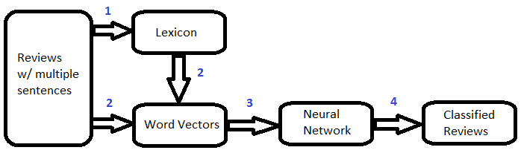
System Design
Bag of Words
Word2Vec
Random Forest

Slide 7
Bag of Words (BOW)
Create & trim lexicon according to frequency.
Use lexicon to create feature vector for entire review.
Train feedforward NN.
Test using 50% of the data.
Uses Adam Optimizer to minimize softmax cross entropy with logits v2.

Slide 8
W2V to NN: System Design
Feature vectors created for each movie review

Slide 9
BOW Experiments
Initial Parameters: 5 runs, average accuracy and runtime recorded.
3 Hidden Layers
500 Nodes
Lexicon frequency bounds 500 > x > 1
Parameters Tested:
1, 2, & 4 Hidden Layers
250, 750, 1000 Nodes
Upper Bounds: 750, 1000; Lower Bounds: 5, 50, 75, 100

Slide 10
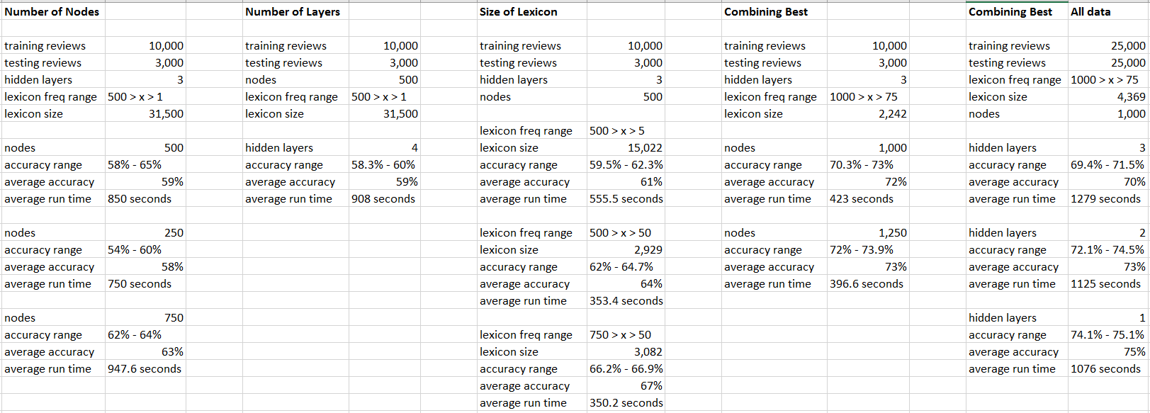
BOW Results

Slide 11
BOW Results
Size of the lexicon had greatest impact on accuracy and runtime of the 3 parameters that were tuned (+ ~9% accuracy from original values).
2nd most important was number of layers + ~7% accuracy, then number of nodes + ~4%.
Best accuracy recorded using this model was 75%.
Creating the lexicon took ~60% of the overall runtime of the entire algorithm.
Word frequency skewed infrequent so lower bound more important.

Slide 12
Conclusions
To improve runtime efficiency of BOW focus on improving the function that creates the lexicon.
To improve accuracy could use a more sophisticated NN, or just use an SVM or Logistic Regression Model.

